Slide 1
Rate Splitting Multiple Access for Nect Generation Cognitive Radio Enabled LEO Satellite Networks
Presented by Wali Ullah Khan et al
Juan Tarrat
University of Alabama in Huntsville
Aug 27 2023

Slide 2
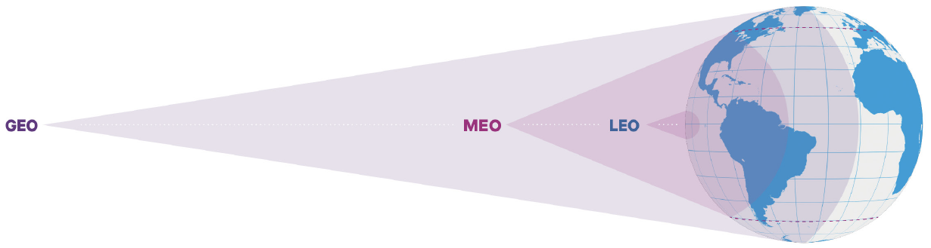
Overview
Three existing SatCom types: GEO, MEO, LEO
LEO has cheaper launching and manufacturing costs than MEO or GEO
Potential of providing global coverage with high-speed data rate and low latency
Main problem: Spectrum scarcity

Slide 3
Paper Contributions
Due to the increasing demand on services, a lot of LEO satellites are required, facing the challenge of limited spectrum resources
Authors propose cognitive radio technique RSMA
The main purpose is to simultaneously accommodate multiple users over the same spectrum and time resources enhancing connectivity
In cognitive radio primary and secondary networks communicate over the same spectrum so that the secondary one does not cause harmful interference.

Slide 4
Paper Contributions II. RSMA
Rate Splitting Multiple Access is a technique used to enhance spectral efficiency.
RSMA’s main purpose is to acoomodate several users over the same spectrum and time resources
Signal transmitted is divided into two parts
Common Part
Private Part
Users reconstruct original signal from each of their parts using successive interference cancellation (SIC).
Two common schemes for RSMA used with linear precoding techniques
1-layer
2-layer
Notes:
1-layer: Simplest scheme and most practical currently in use
2-layer: System categorizes users in different sets. A user’s message is divided into an outer group common message, an inner group message and a private message.

Slide 5
Paper Contributions III
Authors seek an approach that uses cognitive radio for spectral coexistence of GEO and LEO, which according to existing literature has not been yet explored.
Their objective is tro maximize the spectral efficiency of the system under different constraints
They optimized
Power budgets over the beams of LEO satellites
Power allocation coefficients for ground users
Resource block assignment

Slide 6
Paper Contributions IV
The problem for spectral efficiency is not convex and it is challenging to obtain an optimal solution
After applying a convex approximation technique, authors apply Karush-Kuhn-Tucker conditions for power allocation
They also propose an efficient algorithm for subcarrier beam assignment using greedy approach

Slide 7
Paper Contributions V. Summary
Proposal of a cognitive radio enabled for LEO SatCom using RSMA technique. The LEO SatCom operates as a secondary network with the primary GEO SatCom sharing spectrum resources
Guarantee the QoS of LEO
Authors provide two benchmark optimization frameworks
First benchmark optimizes transmit power of RSMA users and resource block user assignment while distributing the power of satellite over different beams equally
Second benchmark optimizes the transmit of power over different beams and RSMA power allocation while assigning resource block user randomly

Slide 8
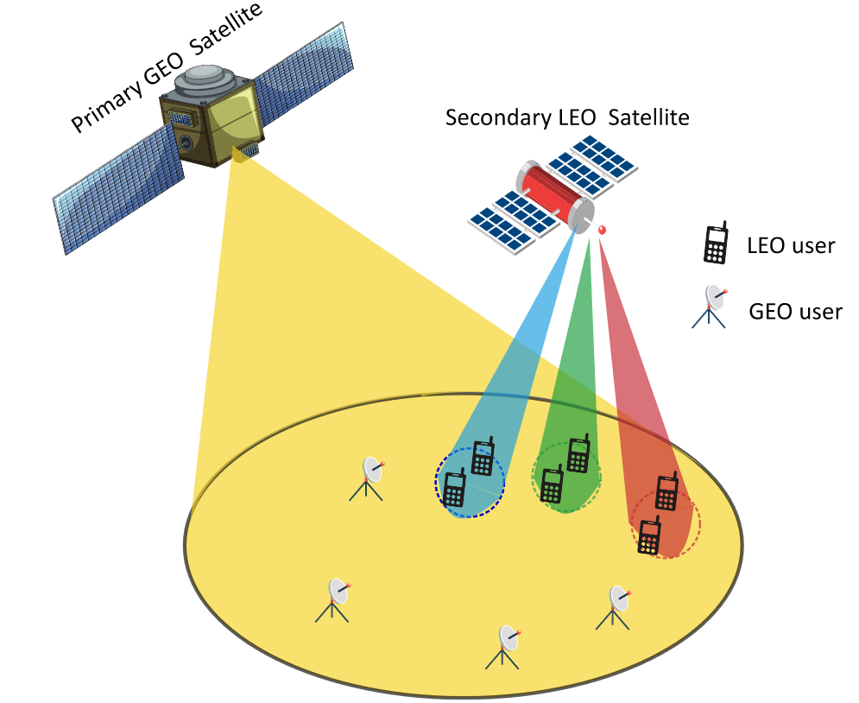
System Model
LEO SatCom operates as a secondary network in the coverage area of primary GEO SatCom network by sharing the same spectrum resources.
The channel state information is perfectly known for the entire network
The proposed system considers a single feed per beam, i.e., only one feed is required to generate one beam
Notes:
System Model of cognitive radio enabled SatCom network using RSMA technique, where a licensed primary GEO SatCom network share the available spectrum resources with unlicensed secondary LEO SatCom network in downlink transmission.
We consider that primary GEO SatCom communicates with ground users using OMA (orthogonal multiple access) technique such that each resource block can accommodate one ground user. Meanwhile, the secondary LEO SatCom solely reuses the same resource block such that each beam accommodates multiple ground users through a single resource block using RSMA protocol

Slide 9
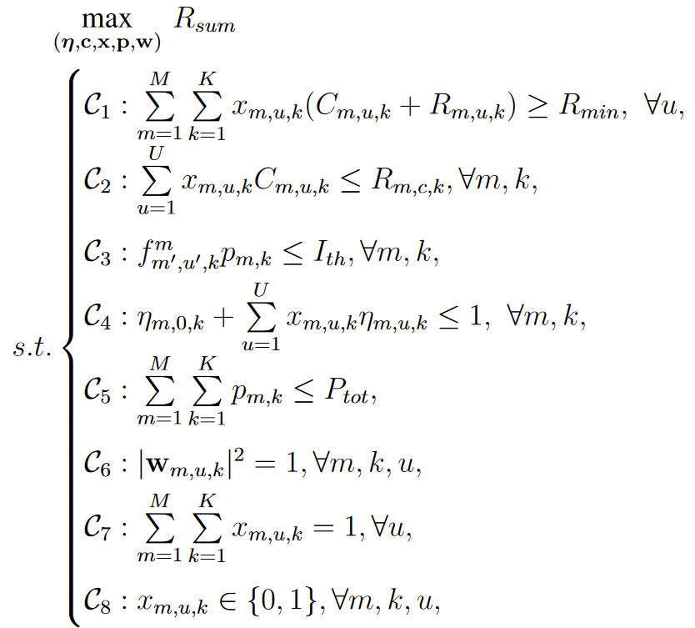
System Model II
The authors work the math for all the different constraints in the optimization framework of joint power allocation and resource block user assignment.
Notes:
C1 guarantees the data rate of u user over k resource block and Rmin denotes the threshold of minimum data rate.
Constraint C2 bounds the proposed framework to successfully decode the common signal of all users associated with m beam over k resource block.
Constraint C3 limits the interference temperature from m beam of LEO satellite to u′ GEO user over k resource block.
Constraint C4 control the total allocated power at each beam while constraint
C5 controls the total energy consumption of LEO satellite, where Ptot shows the total power budget threshold.
C6 represents the precoding vector constraint.
C7 and C8 say that a user should be assigned a single beam and only one resource block.

Slide 10
Proposed Optimization Solution
Authors are able to find a suboptimal but efficient solution given that the joint optimal solution is very hard to find due to the nature of the problem.
Authors first follow cited work to express efficient precoding vectors which balance interference and noise
Two main optimizations
Efficient Power Allocation
Efficient Resource Block User Assignment

Slide 11
Proposed Resource Optimization II. Efficient Power Allocation

Slide 12
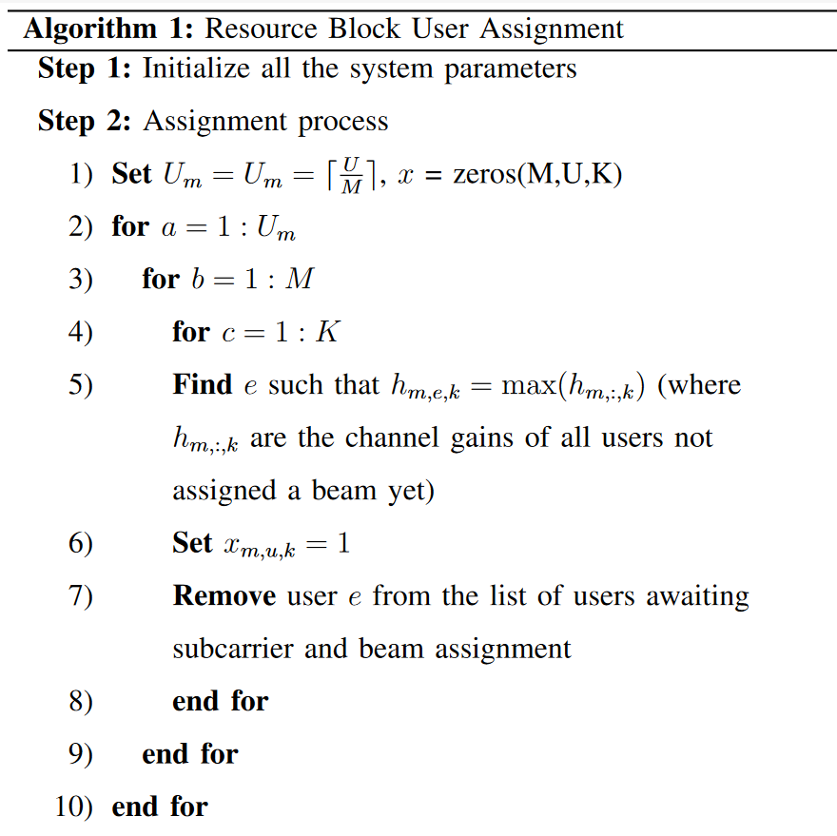
Proposed Resource Optimization II. Efficient Resource Block User Assignment

Slide 13
Conclusion
Cognitive radio and RSMA have the potential to provide massive connectivity in space-ground communication networks
The paper has proposed a RSMA for cognitive radio GEO-LEO satellite networks
In particular, a new solution has been proposed for maximizing spectral efficiency of the secondary LEO system

Slide 14
Extension to Current Work
Considering multiple GEO and LEO satellites such as GEO satellites act as the primary network and LEO satellites as the secondary network
Problem: High levels of interference will be difficult to manage
Solution: Applying reinforcement learning to handle those complex problems, which could be very hard to solve using conventional techniques

Slide 15
Questions?

